Slide 1
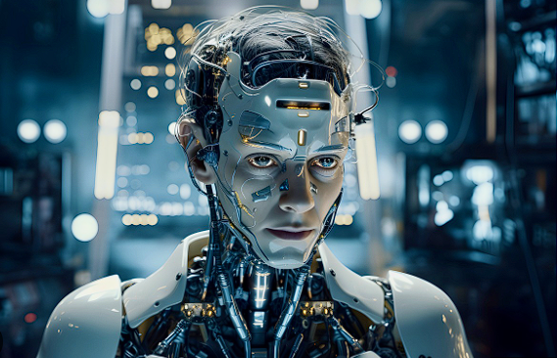
The Future of
Work

Slide 2
Harnessing AI for Workforce Excellence
AI, is a game changer in the way people approach their work
Greater extent of flexibility and promotes a positive trend of happiness index.
We are evolving exponentially example Emerging , First generation and Second generation etc.
Improve communication by 50%, and bump up intelligent quotations by 20%.
Generative AI will automate up to 30% of business activities by 2030 and could also be a $1.3 trillion market by 2032.
Our job duties will be more focused on instructing, reviewing, and supervising than executing.

Slide 3

Key Challenges
➢ People might lose their jobs in certain sectors with AI automating repetitive tasks
➢ Evaluating the quality of work by reducing biasness.
➢ Social biases emerge when models become large, there is probability of untapped potential of LLMS, which may include harmful behaviours that might be dormant but can be unleashed.
➢ Lack of resources, such as capital and powerful hardware required for upcoming innovations and improvements.
➢ Data privacy of user and copyright infringement.
➢ Discontent among employee and employer’s relationships, due to limited human interaction.

Slide 4

Analysis
Today’s labour market and work ethics are significantly transforming with the advancement of technology.
We collaborate with high-tech systems, where we get AI assistance that gives us an edge to redirect our focus to more sensitive issues, and allows us to adapt a better strategic approach as well as draw our attention to meaningful work.
Surveys and research depict that AI capability is far greater than that of humans; they use more sophisticated methods than humans.
We are still at the stage of the human-dominated labour market where most of the repetitive tasks consume most of the administrative, managerial, and worker's time, which results in discontent within the organisation.

Slide 5
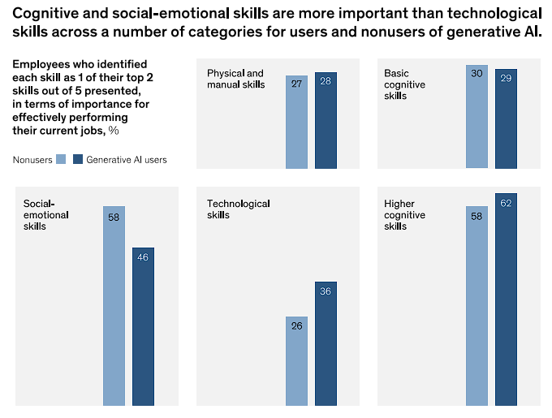
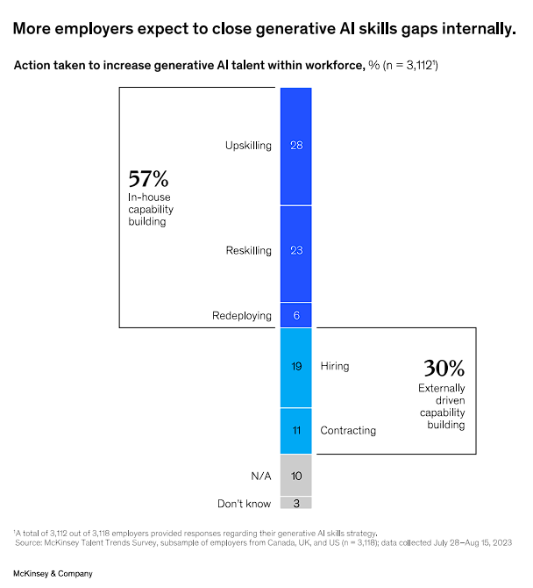
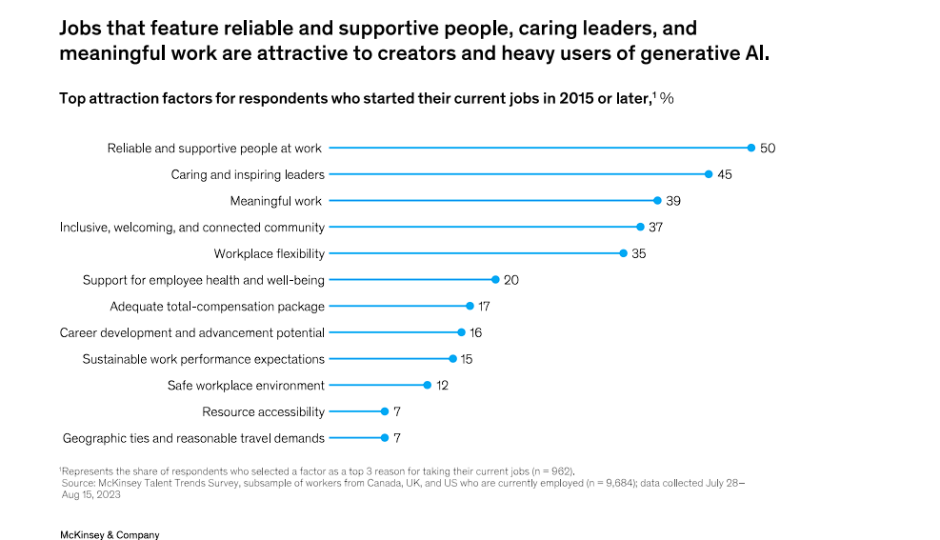
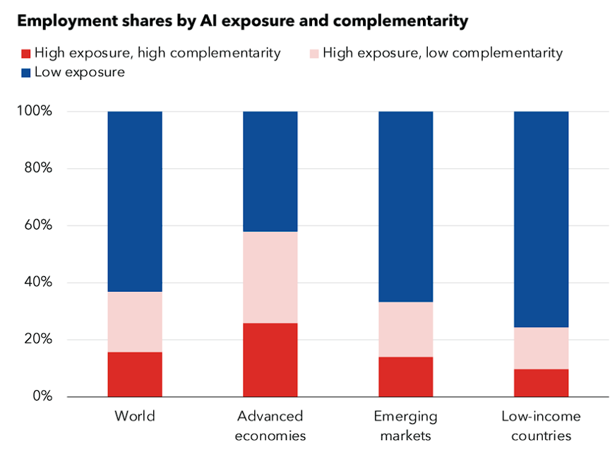

Slide 6
The Advanced AI system recommends databases for relevant job application certification of candidates, fetches coding projects from Git hub, and uses performance ratings to integrate the data to make strong predictions. Generative AI has the expertise to discover new talents by examining adjacent skills that one has selected, which can be readily developed.
Each industry must approach AI in accordance with its own field requirements.
untapped potential risks that should be clearly addressed and taken into consideration.
Most of the companies that sell software to their vendors will then sell services, as powerful AI creations will be capable of performing complex projects from start to finish.
AI will also bridge the gap between onsite and remote workers by empowering them with seamless collaboration across different time zones and geographies.

Slide 7

Traditional, out-dated cost-cutting strategies, frequent layoffs, unfilled positions, and restructuring have resulted in disengagement and dissatisfaction among employees, costing businesses millions of dollars each year.
Our Talent Trends research revealed that employees consistently desire flexibility and meaningful work.
HR should establish standard metrics to measure employee stress and put more weight on emotional wellbeing, evaluate results and financial numbers, and communicate with the CEO to improve senior management decisions.
We must lead by example; only a true confident leader can foster a healthy work environment and help employees reach their maximum potential, which also brings profit to this business.
Happy employees bring prosperity to the business.

Slide 8

Proposed Recommendations
Schedule training programme to reskill existing employees and open doors for more growth opportunities in various roles within organization.
Second generation AI systems to be only built by people with Doctorate in philosophy having serious academic backgrounds with AI, mathematics or Computer science to remove bias.
AI Engineers are working to overcome the issue of system requirements for future advancements.
Adapt strict ethical AI guidelines that can ensure responsible and fair use of AI technologies.
Adapt a human-centric approach, treating employees as first priority and taking care of their mental well-being.

Slide 9

Conclusions
The future of work is a hybrid arrangement where humans will partner up with AI assistance, where there is even a possibility to have our own cloned work buddy working for us who would listen to the recorded meeting, jot down notes for you, send mails, texts, generally limiting human interaction.
To adopt a human-centric approach, where we can prioritise employees' emotional well-being
Technology skills such as basic coding will be the baseline for many jobs, but higher cognitive and social-emotional skills will be differentiators for creative collaborative work in the future.
The AI-driven labour market will have a great payoff if we take care of employees by giving them meaningful tasks, practicing gratitude journals, and scheduling comprehensive training for existing employees to keep them up-to-date with the latest technological advancements
It will also open growth opportunities for employees within the organisation for various roles. Executives that emphasise on the importance of human skills over a simple race for increased output are likely to earn employee’s loyalty and higher profitability over the long run.

Slide 10

References
Bersin, josh. “Understanding AI in HR: A Deep Dive Report”
Peter Capelli, and Ranya Nehmeh, “HR’s New Role” Harvard Business Review.
“Large, Creative AI models will Transform Lives and Labour markets”, The Economist.
Lester, Paul B. Martin Seligman, and Ed Diener. “Top Performers Have a Superpower: Happiness”
Emma Sheppard and Eanna Kelly “The Gen AI Office”
“The Human side of Generative AI: creating a path of productivity”, by Aaron De Smet, Sandra Durth, Bryan Hancock, Marino Baldocchi and Angelika Reich.

